Slide 1
Disclaimer
The text in this slides are supposed to represent the oral notes of the presenter. After each PowerBi Sheet there will be a slide with a narration to match and explain the visuals and analysis

Slide 2
Zomato Analysis
A user social & identity exploration

Slide 3
Objective
The purpose of this analysis is to deepen our understanding of Zomato’s customer base. By examining customer preferences, behavioral patterns, and demographics, this project aims to deliver actionable insights in three critical areas:
1. Areas of Opportunity: Which demographics represent untapped growth potential?
2. Effective Advertising: Which channels, timing, and audience segments yield the highest engagement?
3. Retention Insights: What factors drive repeat purchases, and who are the most loyal customers?

Slide 4
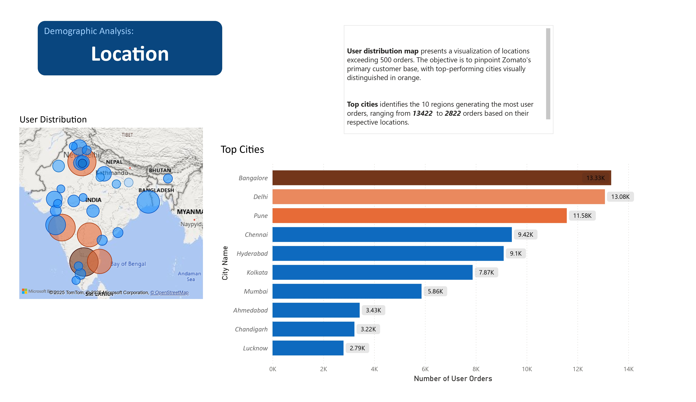

Slide 5
Location Notes
There is a significant distribution of users across the entire map. This demonstrates a wide reach of Zomato’s customer base. Most opportunity for growth is in East India.
We can focus on the 3 most popular areas; Bangalore, Delhi and Pune. This key demographic factor can help us identify successful trends that can be applied to other areas.

Slide 6
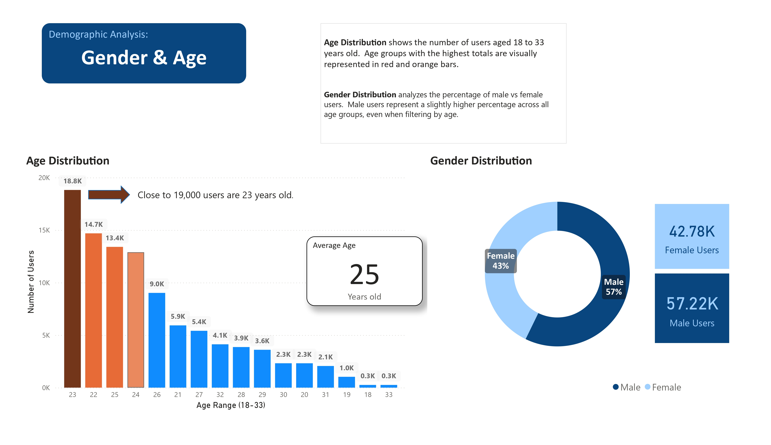

Slide 7
Gender and Age
There is a negligible difference in gender distribution for all users. It is best to focus in other key identifiers to better understand Zomato’s customer base.
Users ages 22-25 represent the grand majority of Zomato's customers. Age will be a key category for further analysis. The average age of all users is 25 years old.

Slide 8
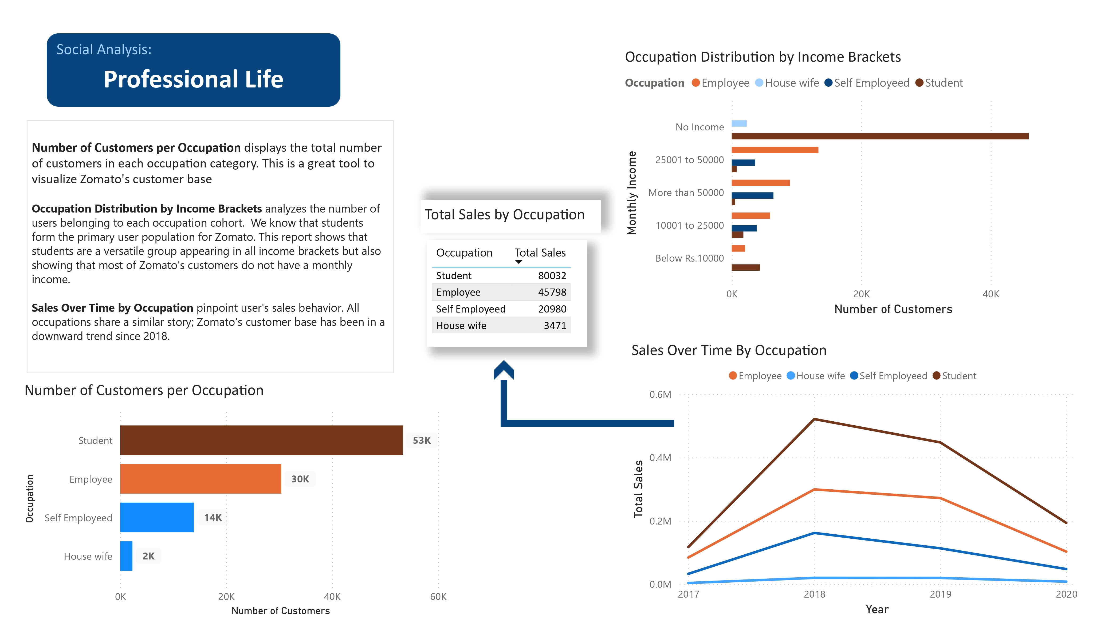

Slide 9
Professional Life
Sales over time show a concerning downward trend in sales year over year. This graph also shows that there is a correlation between number of users and sales.
Students is a very versatile category appearing in all income brackets and representing the majority of Zomato’s customer base. This will be a key identifier for further analysis
Housewives represents a very small percent of users. It’s encouraged to focus on other demographics.
Employe and Self-Employed have the potential to be joint into a single category. As a single category they represent the most opportunity for growth. This can be a key identifier for further analysis.
No income is another identifier that represents a grand majority of Zomato’s user base. While there is a significant overlap with students, “No income” represents a bigger portion of the total number of users and can be an essential category to consider for effective marketing.

Slide 10
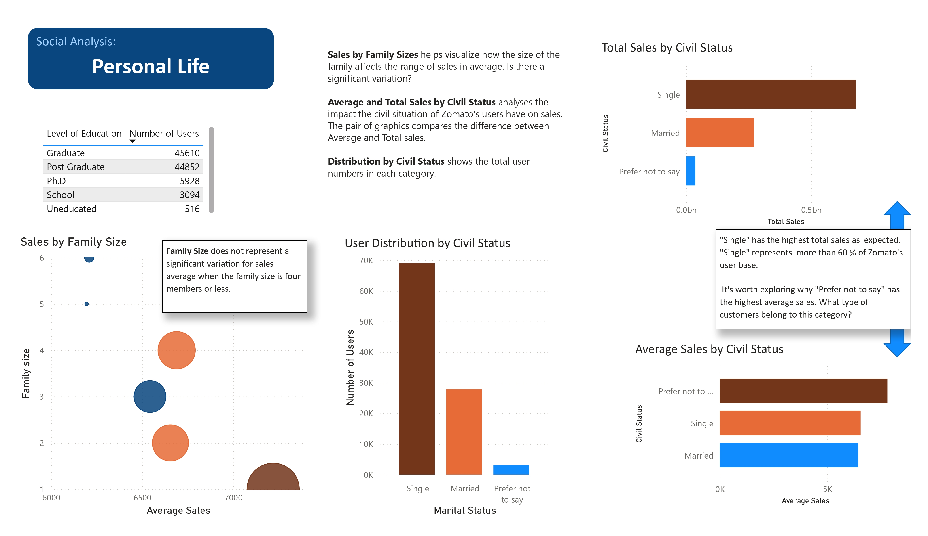

Slide 11
Personal Life
“Prefer Not to Say” has a high average number of orders. Consider additional surveys for this demographic to obtain more valuable data for future analysis on this category.
Single is a key category that can be used to approach the student, employed and self-employed populations which have been identified as important user bases.
Family size has little impact on purchases and there is very little variation for family sizes of 4 or less. This changes with sizes above 4 where sales drop dramatically. Exploring possible causes can be an area of opportunity.
Most of Zomato’s customers are within Graduate or Post-graduate education. This is another great identifier to approach our analysis.

Slide 12
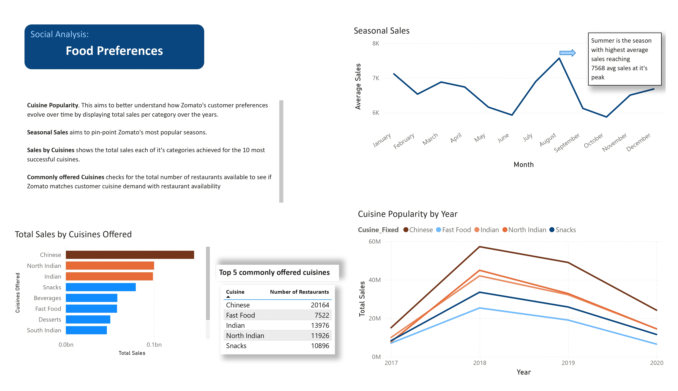

Slide 13
User Preference
Cuisine popularity sales mirrors the same trend as the occupation sales did. Since this loss in sales appears to be uniform across categories it is advised to analyze other areas of the business like the effective use of marketing, changes in local rules and regulations and other possible explanations.
Summer is the season with the highest average sales. Consider running marketing strategies during this time.
Consider adding more restaurants that specialize in Beverages. Cuisine selection availability closely matches user demand.
While Chinese food is the most popular cuisine. It is important to note several restaurants offer many types of Indian food. If we where to add all Indian food subcategories ; East, North, South. Indian food would surpass Chinese food in popularity. Consider adding Generalist Indian Restaurants to Zomato’s offerings.

Slide 14
Summary of findings
Before we do a deeper analysis. Let’s summarize the key categories identified so far;
Income Brackets : “No Income” represents the biggest number of users. (“2500 to over 5000” can be used as a subcategory filter closely matching most of the users under employed and self-employed)
Occupation: “Student” and “Employed and Self Employed “ represent Zomato’s best performing customers and customers with high opportunity of growth.
Ages: 22-25 represent Zomato’s top customers.
Location- Most customers can be found in 3 key cities: Bangalore, Delhi and Pune.

Slide 15
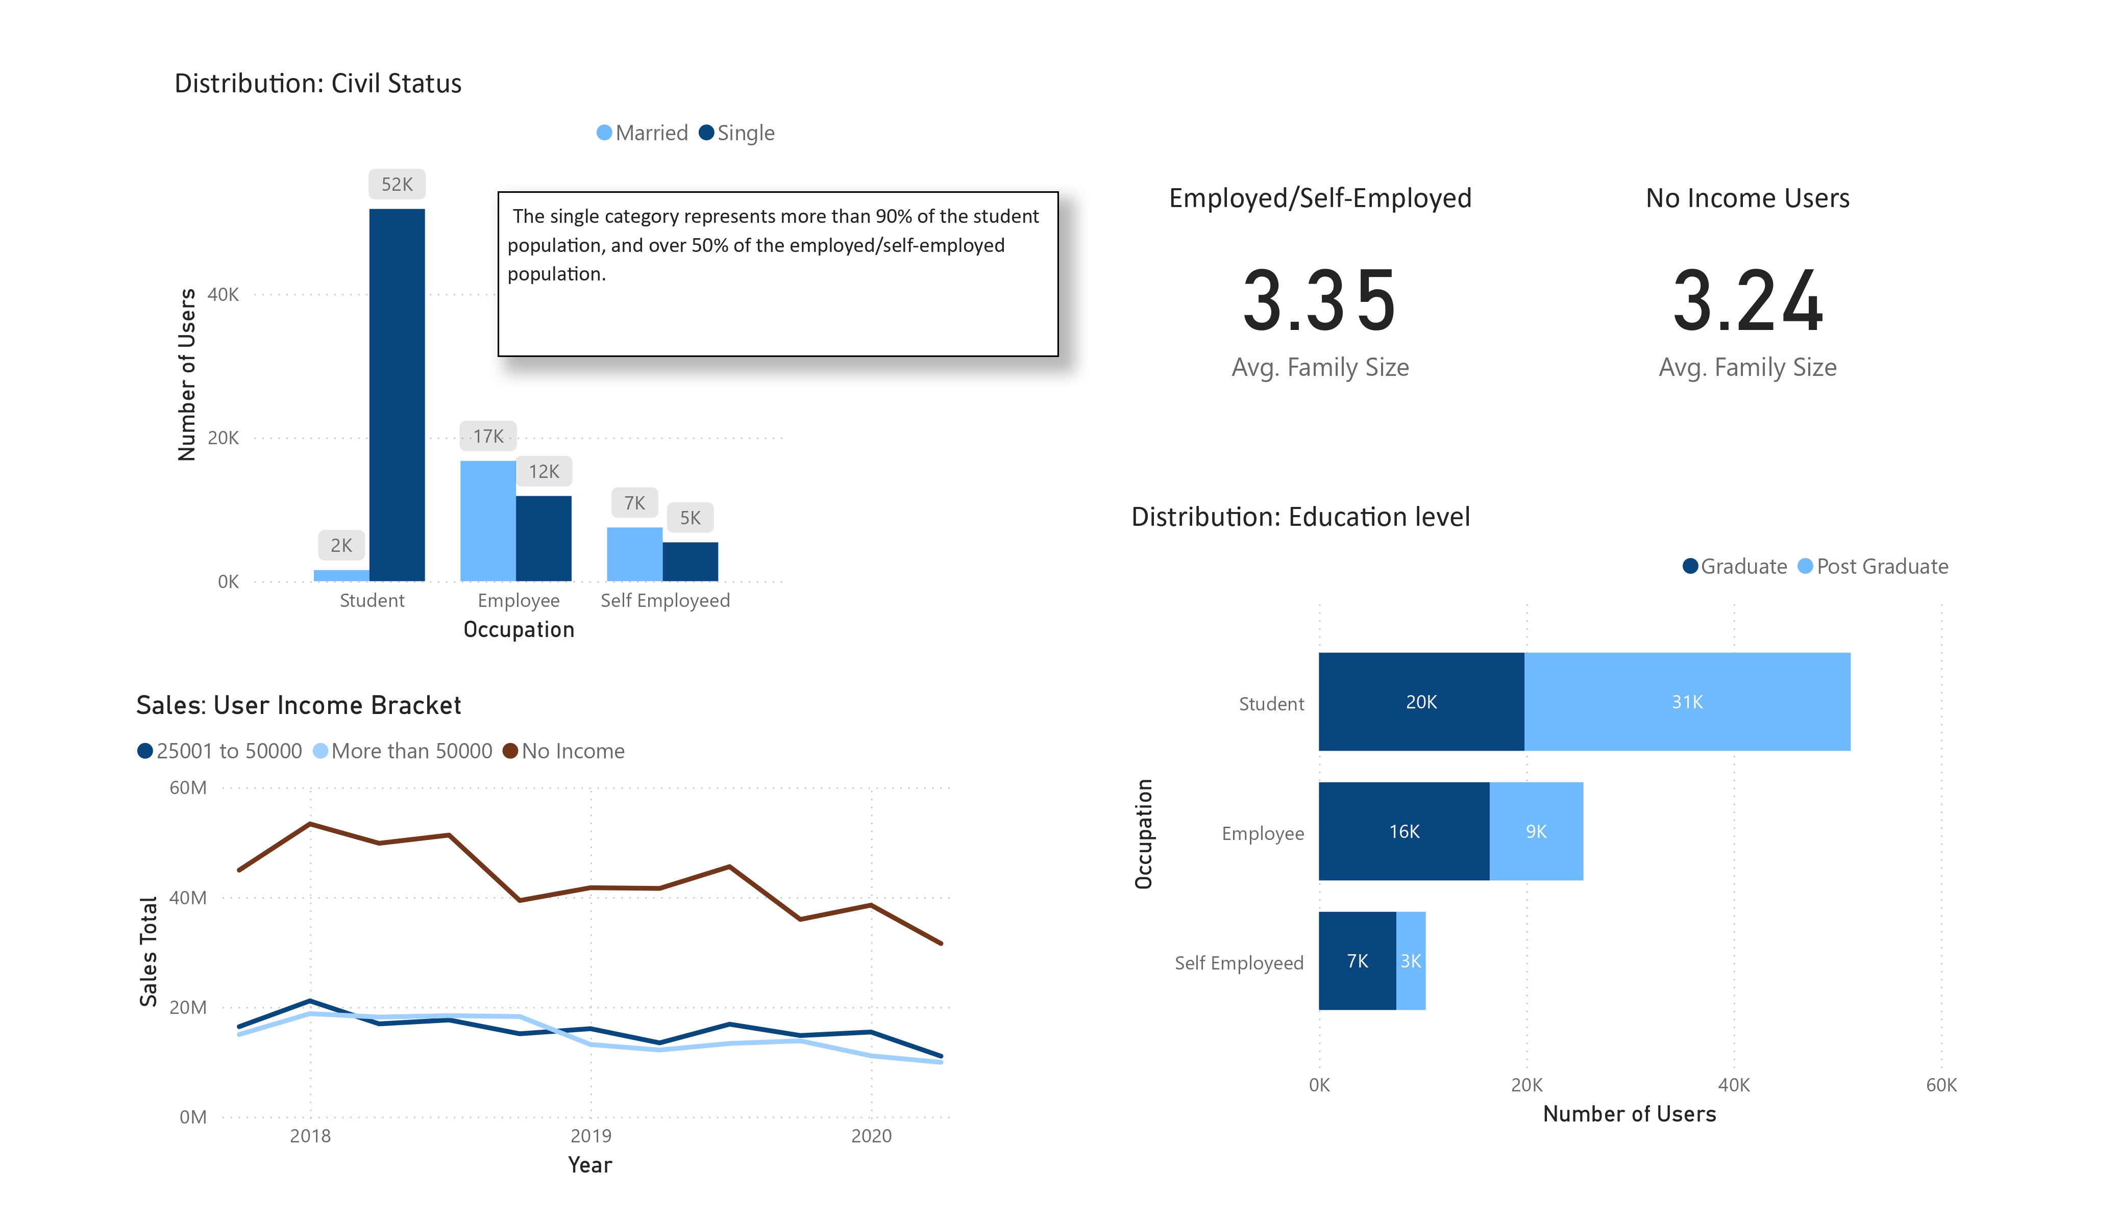

Slide 16
Exploration Findings
Single has proven to be a versatile category that includes Student, Employed and Self-Employed users.
The average family size stays consistent even with students and or “no income” population.
Most employed and self-employed users belong to the Graduate education level.
Sales by income bracket targeting “no income” users and “Employed and Self Employed” show once again that there is an overall downward trend in sale, the cause likely unrelated to user demographics or preferences.

Slide 17
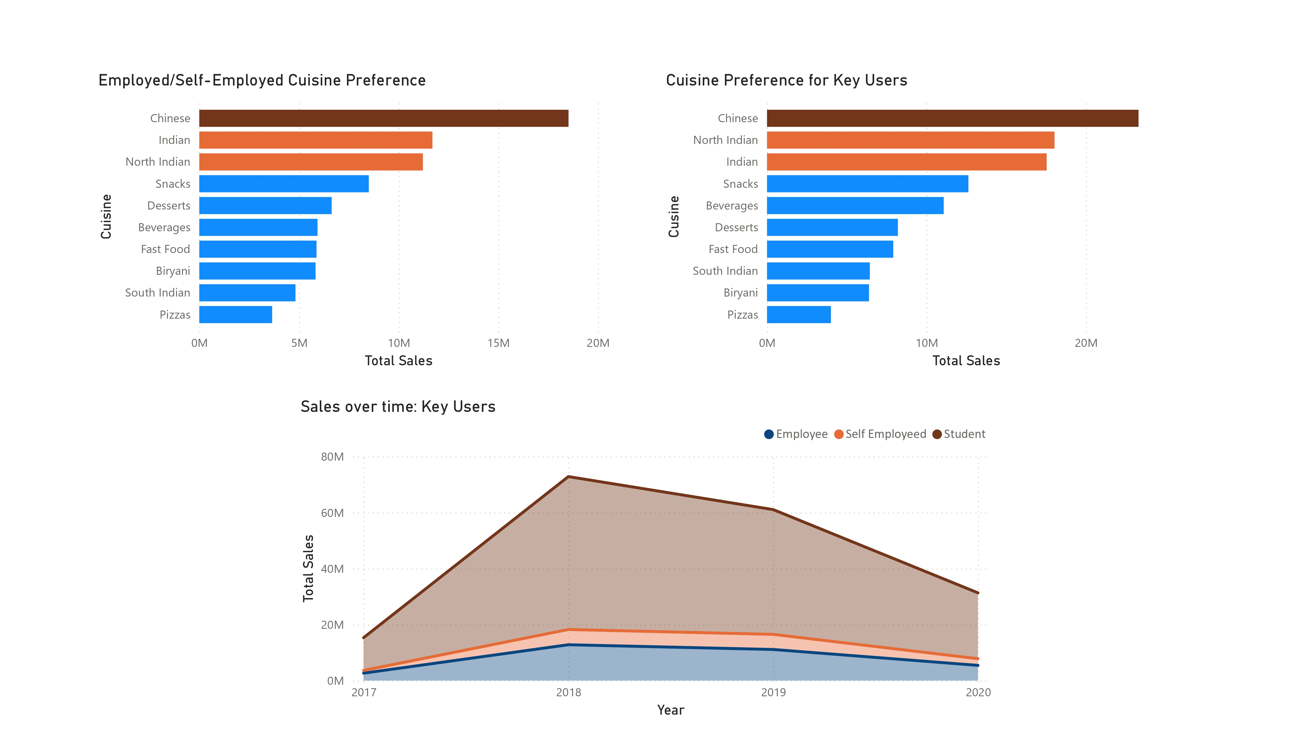

Slide 18
Exploration findings
Cuisine preference utilizing all key identifiers; Location, Age, Occupation and Civil Status remains stable with very slight variations. This indicates that cuisine preference is likely cultural and does not change much between different demographics within this area.
Sales over time for key users shows the same downward trend. This is the third example, supporting the theory that demographics and user preference is not a likely cause of the loss of sales. This graphic utilizes all of the key identifiers and helps visualize the high impact “Student” users have on sales.

Slide 19
Conclusions
A great portion of Zomato’s users have no income. It’s likely they are being supported by third parties. It may be a good idea to create family plans and promotions so that parents can link payment options with their children accounts.
Students represent a big part of Zomato’s users. Marketing campaigns in college areas and student discounts and promotions have the potential to increase performance.
Spotting similarities for the Employed/Self-Employed populations can be a solution to create marketing campaigns that target both user bases. This is Zomato’s second largest population with great opportunity for growth
Further analysis of circumstantial trends is advised to identify why the sales are down year over year for all categories.
All marketing campaigns should have the average Age range in mind. Zomato’s customers are young adults so the tone and approach should consider current trends.

Slide 20
Conclusions
Families with more than 4 members may struggle to justify the cost of delivery and eating out. It may be worth researching if adding restaurants that offer bulk options can help with tapping into this customer base
It is not possible to track retention of users at the moment. It is advised to create individual accounts for users to track their history over time. It may be worth considering a subscription model that offers low-cost delivery as a perk.
There is a great number of restaurants that have very little sales. While it is important to have variety it may be worth considering shortening the list of available options to streamline the selection process for customers.

